Slide 1
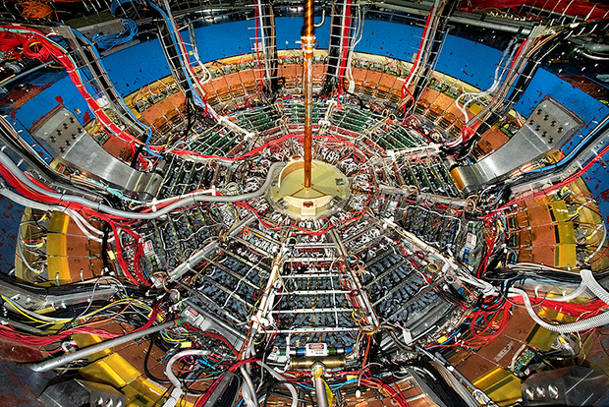
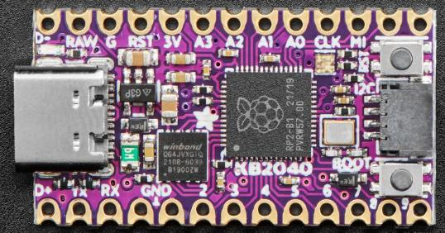
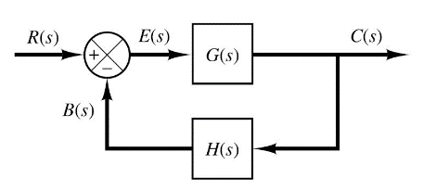

Control Systems
Engineering
(CSE 201)
Student #1
Student #2
Student #3
Team 09
RLC Resonance
Spectrum Analyzers

Slide 2
Our Challenge: Build a Spectrum Analyzer
A spectrum analyzer (SA) is an advanced benchtop instrument used to measure a circuit's response as the circuit's inputs are systematically swept across a wide range of frequencies
By plotting circuit measurements like output voltage, the SA can help identify the frequencies that induce resonance
This analysis is crucial when designing radios and antennas that can transmit and receive signals at specific frequencies
We need a SA to design and test cell towers, Wi-Fi stations, GPS satellites, radar detectors, laser ranging devices, and even acoustical instruments

Slide 3
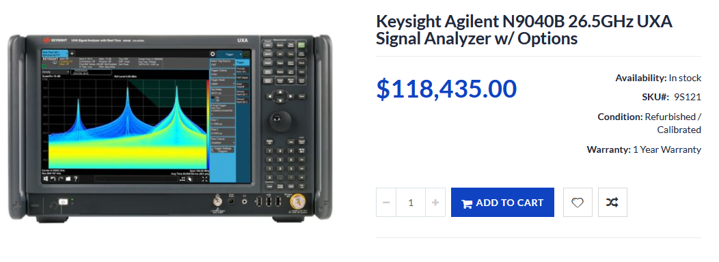
Finding a Circuit's Resonant Frequency
☹
Our challenge was to use a $10 KB2040 to determine the resonant frequency of an RLC circuit
Team 08 already simulated our RLC circuit being driven by an AC voltage source…

Slide 4
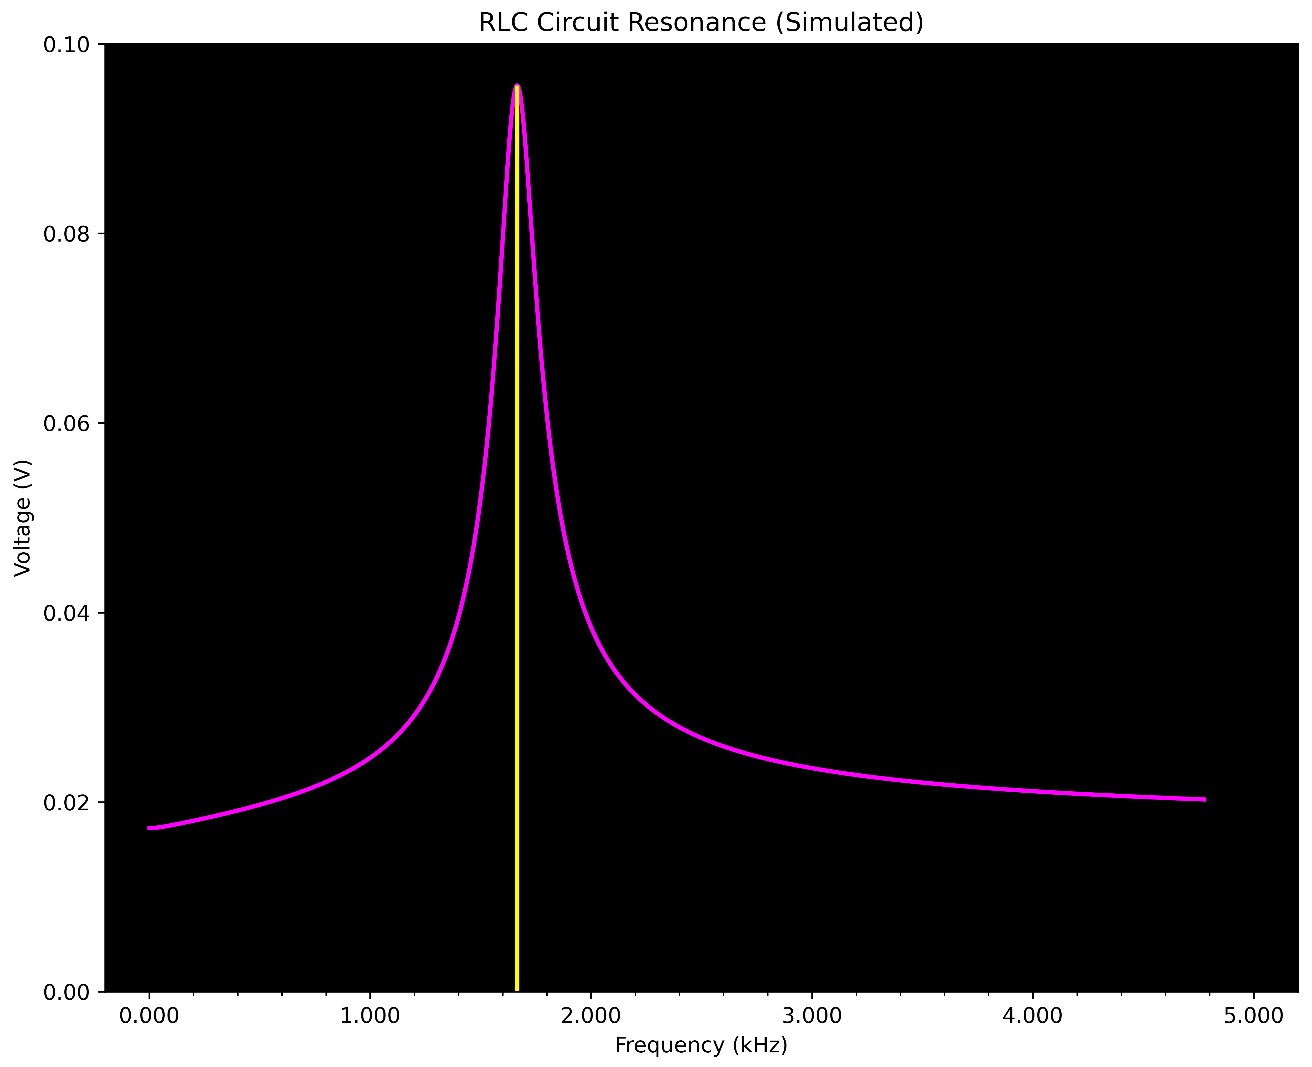
Team 08 Results

Slide 5
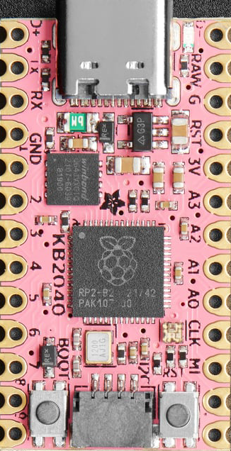
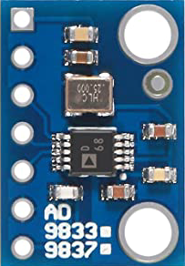
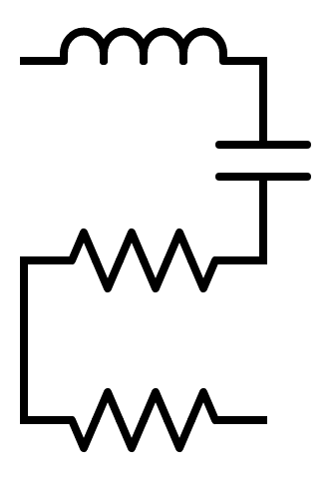
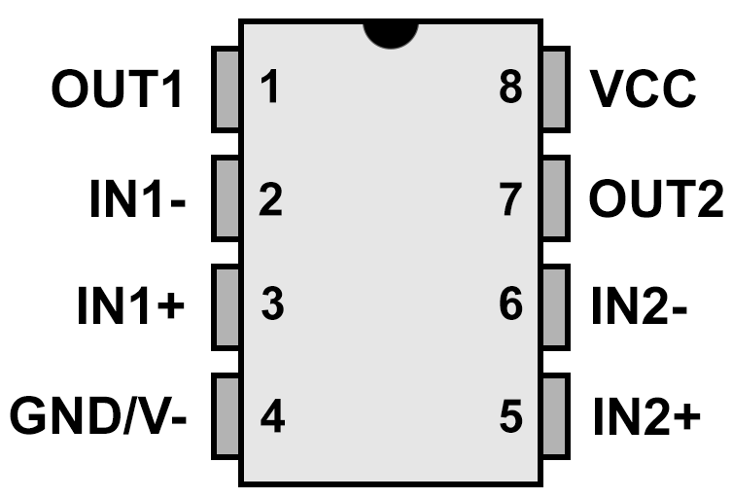
Our Approach
The RLC Circuit is "powered" (driven) by the AD9833+TLV2462
Signal Generator
100mH
100nF
V_{OUT}
SPI Bus
10Ω
TLV2462
Op Amp
We will measure the voltage at the 10Ω resistor
100Ω
Op-Amp

Slide 6
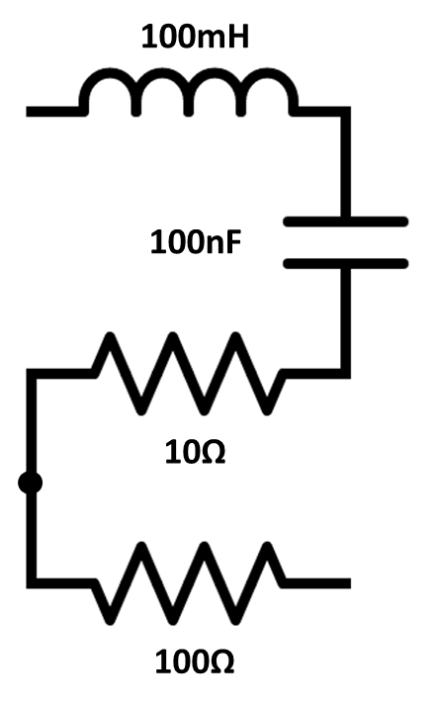
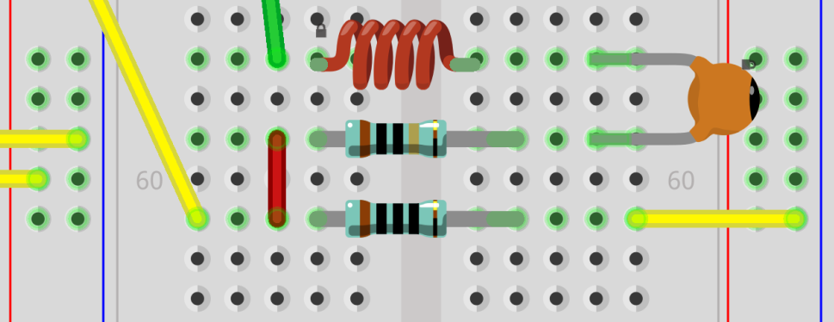
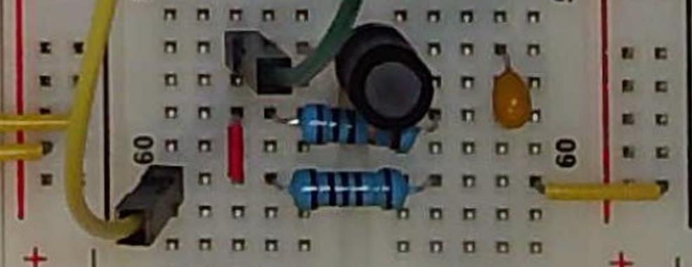
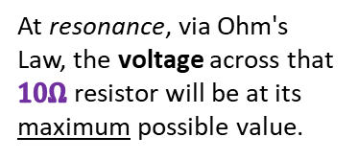
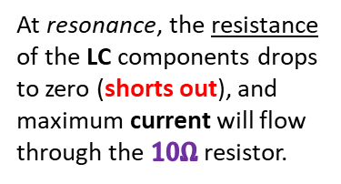
Our Approach
+
10Ω
Voltage
100Ω
-
GND
At resonance, the resistance of the LC components drops to zero (shorts out), and maximum current will flow through the $10Ω$ resistor.
At resonance, via Ohm's Law, the voltage across that $10Ω$ resistor will be at its maximum possible value.

Slide 7
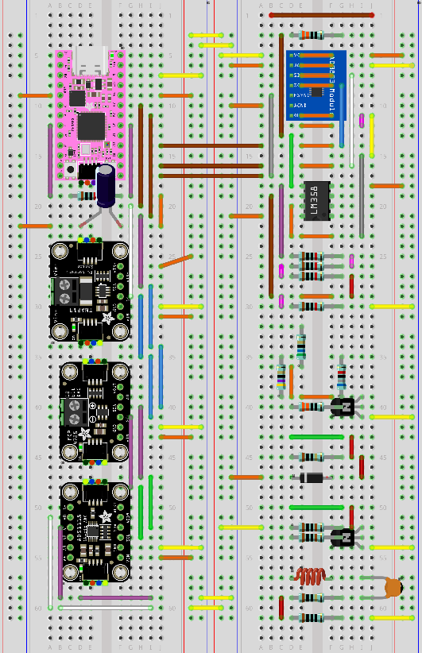
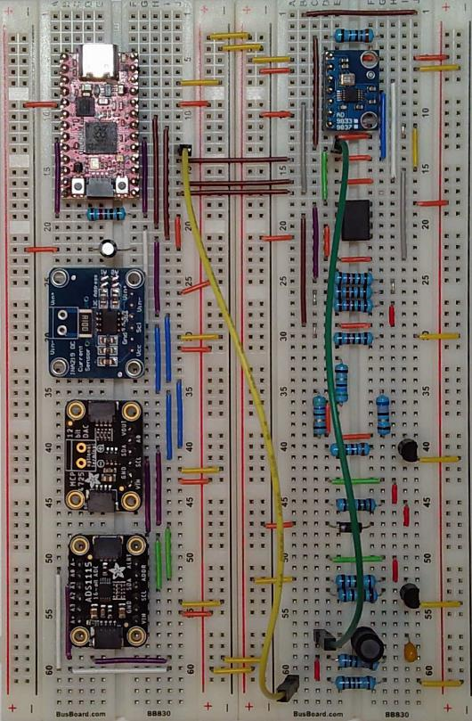
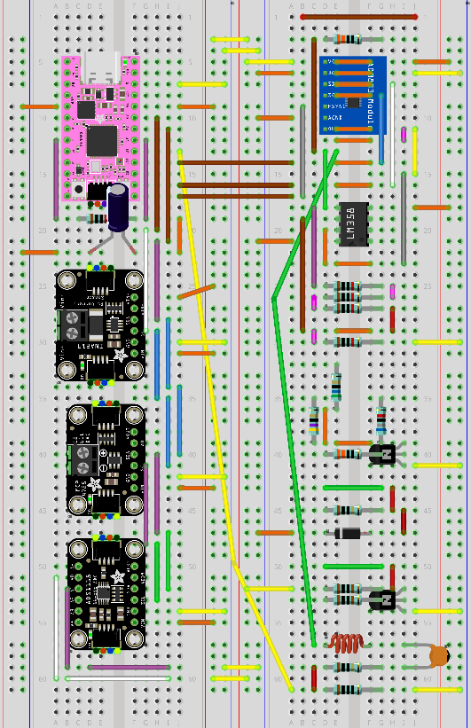
Our Approach

Slide 8
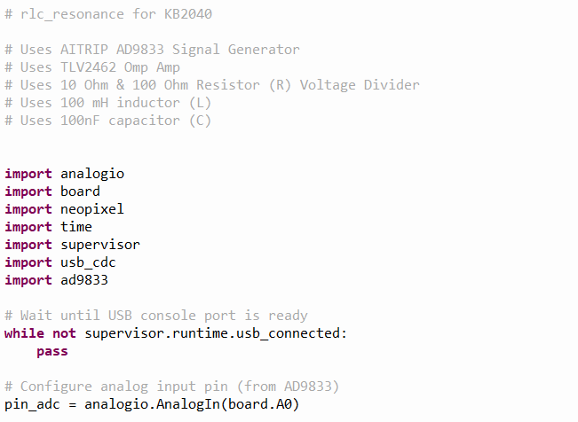
Our Solution
①
②
③
④

Slide 9
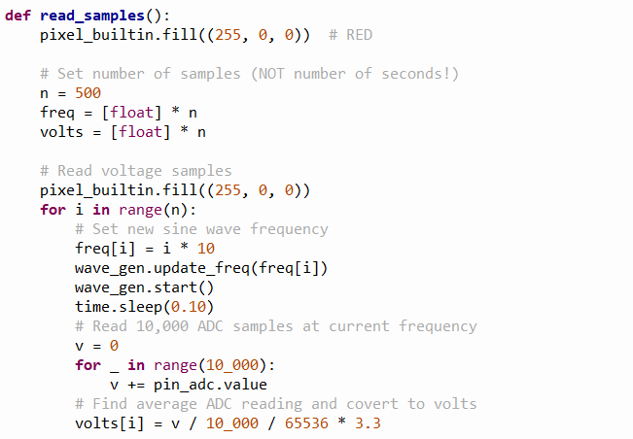

Our Solution
①
②
We will sweep from 0 to 5 kHz
$$500×10=5000 Hz (max)$$
The AD9833 CircuitPython library handles all the communication over the SPI bus
③
④
⑤
⑥
⑦
⑧

Slide 10
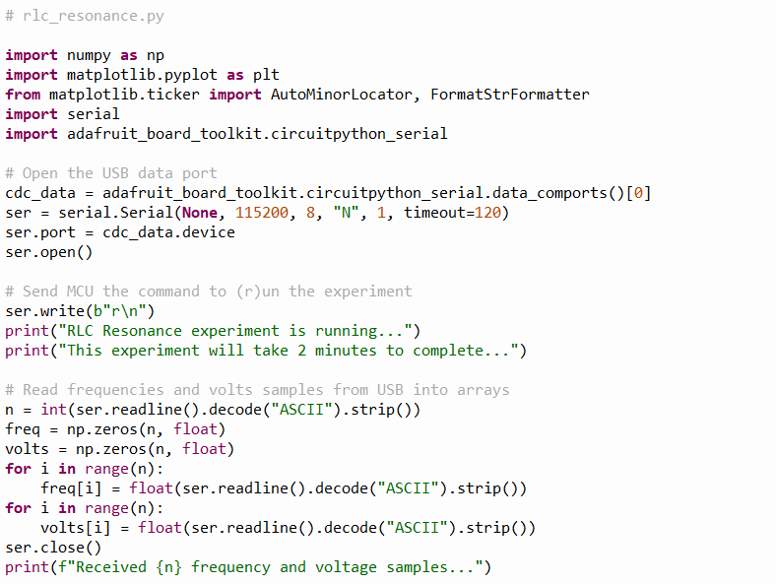
Our Solution
①
②
③
④

Slide 11
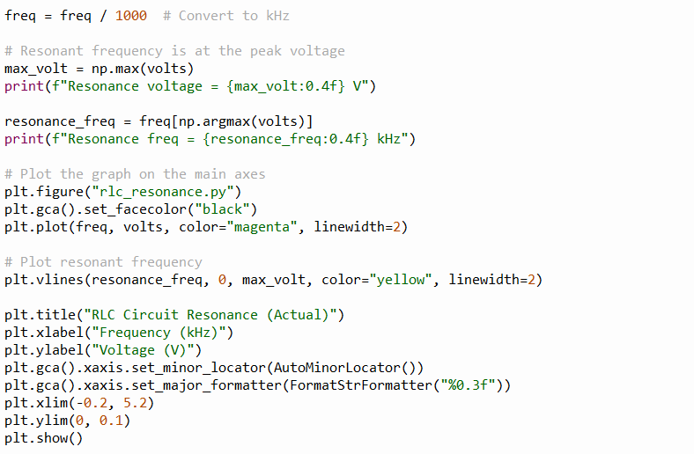
Our Solution
①
②
③
④
⑤
⑥
⑦

Slide 12
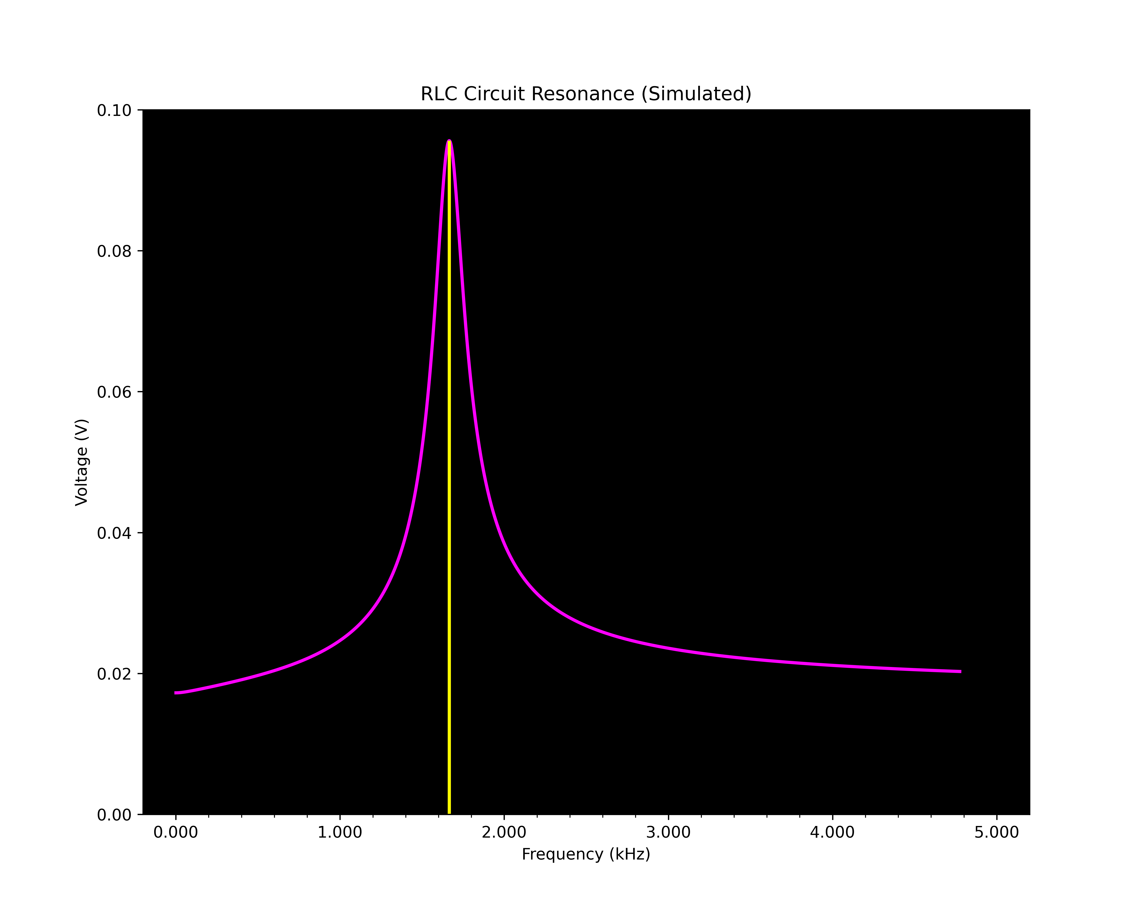
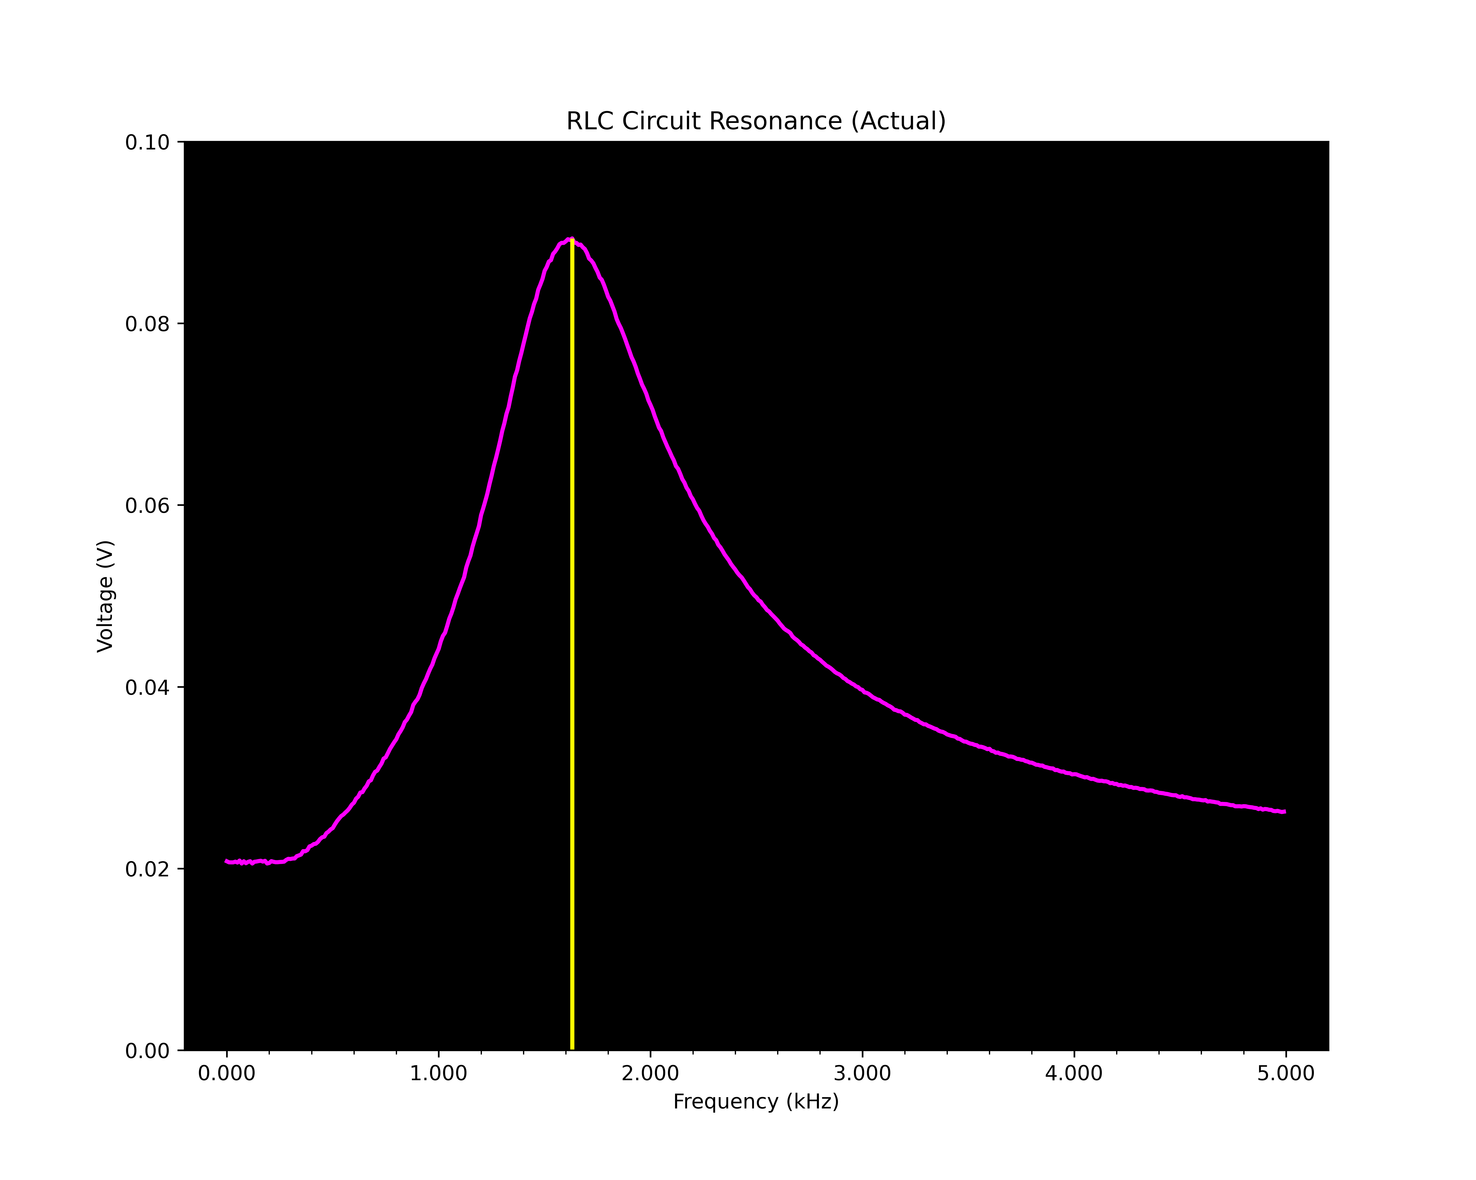


Our Results
Simulated
Actual
High Q Factor
Low Q Factor
Engineers must contend with the real world where nothing is exact or consistent

Slide 13
Team 09 – What We Learned
It is possible to determine the resonant frequency of an RLC circuit using an inexpensive microcontroller, at least for low frequencies with a low selectivity (Q factor)
Our experimental results agreed reasonably with the theoretical exact answer (~2% relative error) – our job as engineers is to understand the root causes for the deviations and to design improved circuits
The 12-bit ADC built into the RP2040 is fast but less precise than the high-resolution 16-bit ADC breakout board. However, we could not use the 16-bit ADC because the KB2040 could not simultaneously use both its I2C bus to talk to the 16-bit ADC and the SPI bus to talk to the signal generator

